Slide 1
Java Web
JSP – JavaServer Pages

Slide 2
Disclaimer
Document Name:
Data Classification: INTERNAL
Disclaimer
The contents of this document are property of Softtek, and are classified as Confidential. Any reproduction in whole or in part is strictly prohibited without the written permission of Softtek.
This document is subject to change. Comments, corrections or questions should be directed to the author.
Audience/Viewership | Purpose
Java Beginners | Training
Revision Chart
The following chart list the revisions made to this document. Use this to describe the changes and additions each time this document is re-published. The description should be detailed as possible and include the names of the reviewers who request the changes.
Version No. | Version Date | Types of Changes | Owner/Author | Date of Review/Expiration
1 | 2015/08/06 | Creation | Luis Robles | NA

Slide 3
Lesson 3: JavaServer Pages

Slide 4
Drawbacks of Servlets
To develop a servlet program, a strong background knowledge of Java is necessary i.e, a proficient Java programmer only can write servlet programs efficiently but highly difficult for non-Java programmers like web designers.
In servlets, there is no separation between regular business logic and presentation logic ( in a single servlet we write both presentation and business logic)
Servlets are very powerful, but they're not easy to program. As a result, they haven't become very popular.

Slide 5
Why JSP?
JSP eliminates the limitations of Servlets.
JSP is tag based+internal powerful features of Servlets
JSP was an answer over ASP Technology
JSP is built on top of servlets, but JSP is much easier to program
Internally, each JSP page is actually converted into a servlet by the server

Slide 6
Introduction to JSP
JSP is a technology that is built on top of servlets technology
The key advantages of jsp technology are:
It is easy to separate business logic from presentation logic.
Developing JSP applications is easier than manually developing servlets.
By using EL expressions,Custom tag libraries in jsp’s we can completely eliminate the JAVA code.
As part of the every web container a tool called JSP compiler will be provided.
This tool is responsible for reading the JSP and generating JAVA code in a java file
The jspc uses the java compiler to generate the class file(Servlet class) from the java file

Slide 7
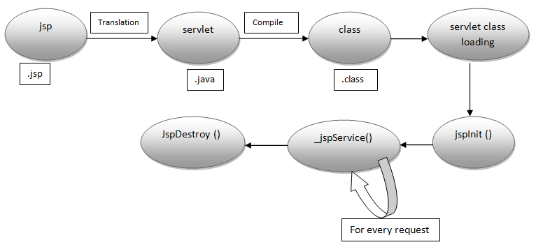
JSP Lifecycle

Slide 8
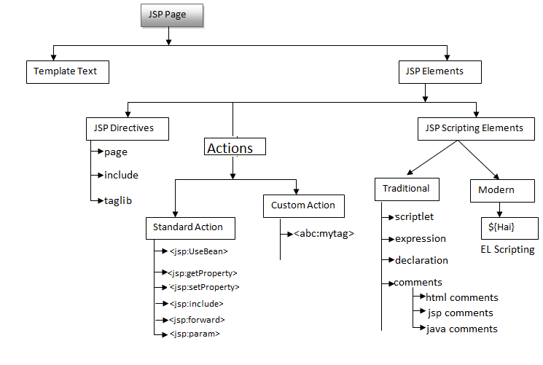
JSP Elements

Slide 9
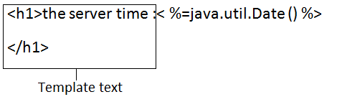
Template Text
It contains HTML and XML tags and raw data .For the template text no processing is required and it will be passed directly as argument to out.write() in _jspService() method.

Slide 10
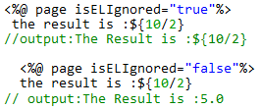
JSP Directives
Examples:
%@ page import="java.util.*"%>
The server time is:<%=newDate()%>
<%@ page import="java.util.*"%>
<%@ page import="java.sql.*"%>
<%@ page session="false"%>
<%@ page contentType="image/JPEG"%>
<%=request.getParameter("uname")%>
These can provide translation time instructions to the jsp engine like session tracking is required or not,is current jsp error page or not,which scripting language we are using in jsp etc.
Types:
Page Directive:
<%@ page attrname=attrvalue%>
Include Directive:
<%@ include file="header.jsp"%>
Taglib Directive:
<%@taglib prefix="mine" uri="www.java2learn.com"%>

Slide 11
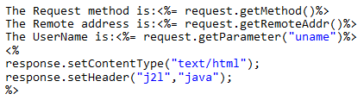
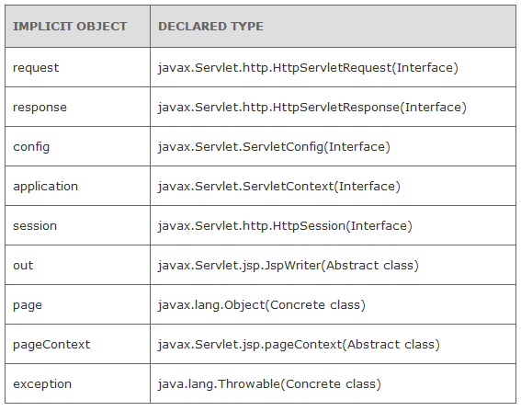

JSP implicit objects
For Instance:

Slide 12
Java code in JSP pages
JSP expressions
Expressions of the form
<%= Java Expression %>
which are evaluated and inserted into the servlet’s output.
JSP scriptlets
Scriptlets of the form
<% Java Code %>
which are inserted into the servlet’s _jspService method (called by service).
JSP declarations
Declarations of the form
<%! Field/Method Declaration %>
Which are inserted into the body of the servlet class, outside any existing
methods
JSP comment
<%-- JSP Comment --%>

Slide 13

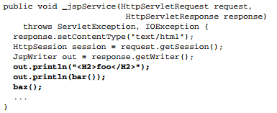
JSP → Servlet code
Sample JSP Expression/Scriptlet
Representative resulting Servlet Code: Expression/Scriptlet

Slide 14
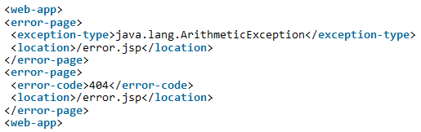


Configuring error pages in the JSP
Declarative approach
Programmatic approach
first.jsp
second.jsp

Slide 15
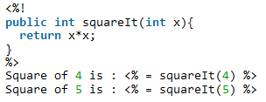



JSP Standard Actions
Some examples:
Send parameters:
first.jsp
second.jsp

Slide 16
Directives Summary
Directives are elements that relay messages to the JSP container and affect how it compiles the JSP page.
Page.
Include.
TagLib.

Slide 17
@ Page
Defines page-dependent attributes, such as scripting language, error page, and buffering requirements.
Syntax
<%@ page attribute="value" %>
<jsp:directive.page attribute="value" />

Slide 18
@Page Attributes
buffer | Specifies a buffering model for the output stream.
autoFlush | Controls the behavior of the servlet output buffer.
contentType | Defines the character encoding scheme.
errorPage | Defines the URL of another JSP that reports on Java unchecked runtime exceptions.
isErrorPage | Indicates if this JSP page is a URL specified by another JSP page's errorPage attribute.
extends | Specifies a superclass that the generated servlet must extend
import | Specifies a list of packages or classes for use in the JSP as the Java import statement does for Java classes.
info | Defines a string that can be accessed with the servlet's getServletInfo() method.
isThreadSafe | Defines the threading model for the generated servlet.
language | Defines the programming language used in the JSP page.
session | Specifies whether or not the JSP page participates in HTTP sessions
isELIgnored | Specifies whether or not EL expression within the JSP page will be ignored.
isScriptingEnabled | Determines if scripting elements are allowed for use.

Slide 19
@ Include
Is used to includes a file during the translation phase. This directive tells the container to merge the content of other external files with the current JSP during the translation phase.
Syntax.
<%@ include file="relative url" >
<jsp:directive.include file="relative url" />

Slide 20
@ TagLib
Declares that your JSP page uses a set of custom tags, identifies the location of the library, and provides a means for identifying the custom tags in your JSP page.
Syntax
<%@ taglib uri="uri" prefix="prefixOfTag" >
<jsp:directive.taglib uri="uri" prefix="prefixOfTag" />

Slide 21
Actions Summary
Standard actions
Custom Actions
Life cycle.

Slide 22
Standard Actions
Provides a bunch of standard action tags that we can use for specific tasks such as working with java bean objects, including other resource, forward the request to other resource etc.

Slide 23
Standard Actions
jsp:include | To include a resource at runtime, can be HTML, JSP or any other file
jsp:useBean | To get the java bean object from given scope or to create a new object of java bean
jsp:getProperty | To get the property of a java bean, used with jsp:useBean action
jsp:setProperty | To set the property of a java bean object, used with jsp:useBean action.
jsp:forward | To forward the request to another resource.
jsp:text | To write template text in JSP page.
jsp:element | To define the XML elements dynamically.
jsp:attribute | To define the dynamically generated XML element attributes
jsp:body | To define the dynamically generated XML element body
jsp:plugin | To generate the browser-specific code that makes an OBJECT or EMBED tag for the Java plugin.

Slide 24
Custom Actions
- BodytagSupport
The BodyTagSupport class implements the BodyTag interface and adds additional convenience methods including getter methods for the bodyContent property and methods to get at the previous out JspWriter.
- SimpleTagSupport
The SimpleTagSupport class implements the SimpleTag interface and adds additional convenience methods including getter methods for the properties in SimpleTag

Slide 25
Links and References
https://docs.oracle.com/javaee/5/tutorial/doc/bnahe.html
http://www.oracle.com/technetwork/articles/java/code-convention-138726.html

Slide 27
Luis Robles
luisf.robles@softtek.com
Related to training material
(Java Web module)
Erio Cesar García Lujan
erio.garcia@softtek.com
Instructor

